Slide 1
MINISTRY OF SCIENCE AND HIGHER EDUCATION OF THE RUSSIAN FEDERATION FEDERAL STATE BUDGET EDUCATIONAL INSTITUTION OF HIGHER EDUCATION VORONEZH STATE UNIVERSITY OF FORESTRY AND TECHNOLOGIES NAMED AFTER G.F. MOROZOV Viruses of endophytic and pathogenic forest fungi
WRITTEN BY: Zhilenkova E.S., LD4-201-OM
CHECKED BY: Maklakova E.A., Doctor of Philology

Slide 2
Keywords: Mycovirus, Fungal endophytes, High-throughput sequencing, Fungi, Mycobiome, Endophyte virus, Origin of mycoviruses, pathogenicity, hypovirulence.

Slide 3
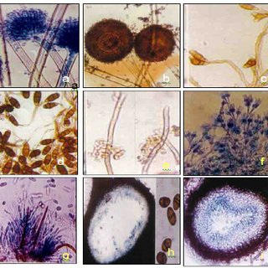
Fungi that reside inside living organisms without causing visible symptoms during at least one part of their life cycle are generally known as endophytic fungi.

Slide 4
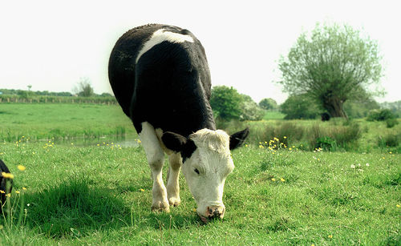
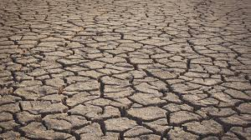
Endophytes enhance the host's defenses against herbivores and increase resistance to various stressors such as drought.

Slide 5
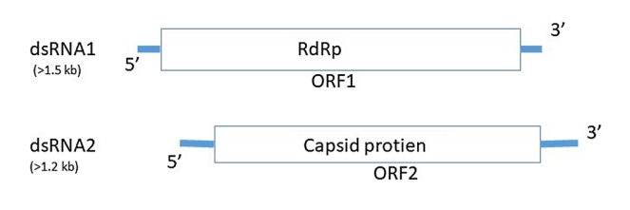
Currently, hundreds of mycoviruses have been discovered, with most of the known species having a double-stranded RNA (dsRNA) genome, and a small part having either a single-stranded RNA (ssRNA) or a single-stranded DNA (ssDNA) genome.

Slide 6
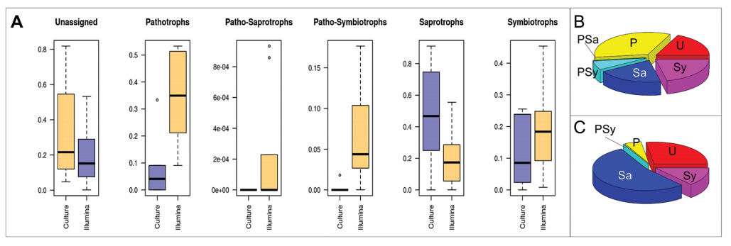
Relative abundance of leaf-inhabiting fungal endophytes of European beech trees among the main trophic guilds or associations.

Slide 7
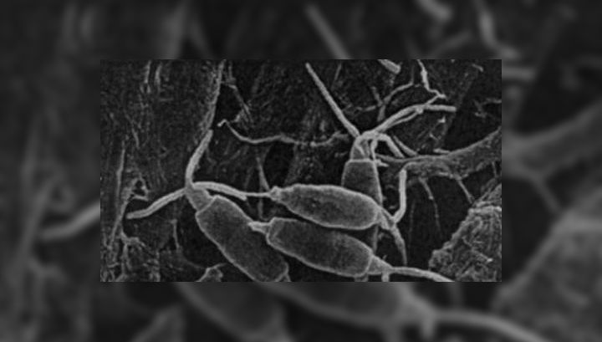
Recent estimates indicate that there are between 1.5 and 10 million fungal endophyte species, and scientists have stated that 30-80% of fungal species can be infected with mycoviruses.

Slide 8
The origin of mycoviruses:
The first hypothesis for the origin of mycoviruses is the ancient co-evolution hypothesis, which suggests that viruses and fungi evolved together over time.
The second hypothesis suggests that mycoviruses evolved from plant viruses and occupied the niche of infection of plant-associated fungi.

Slide 9
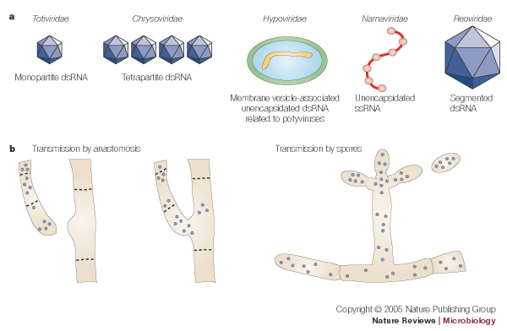
Some mycoviruses reduce the virulence of the host fungus (hypovirulence), which can make the fungus less harmful to plants, while other mycoviruses have been shown to increase the virulence of the fungus host (hypervirulence).

Slide 10
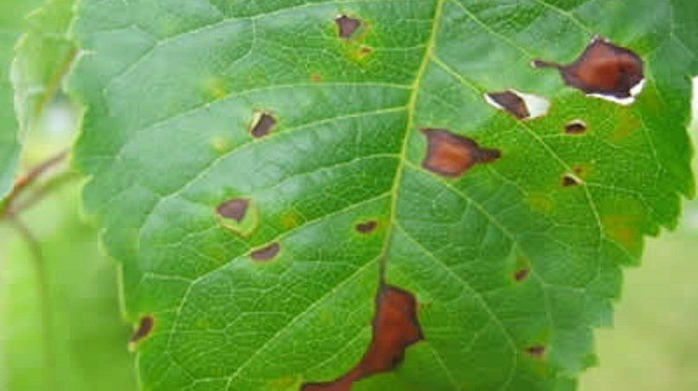
Thus, depending on the mode of action, mycoviruses can be used as potential bioagents for combating fungal diseases.

Slide 11
Thanks for your attention

